Slide 1
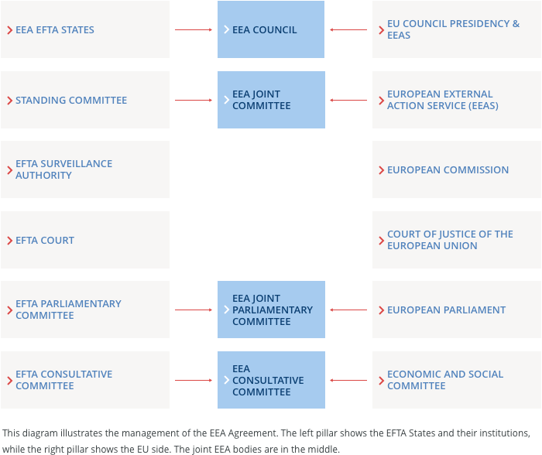
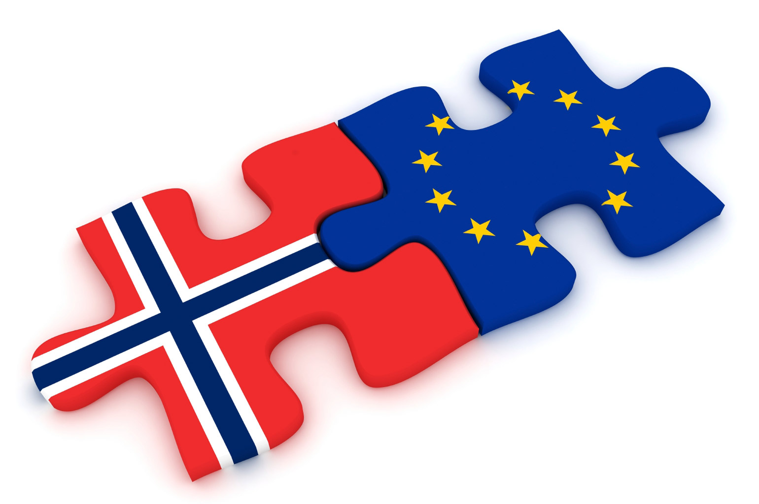
Norway and the European Union
History Of Relations
The EEA Agreement
Further Cooperation
Vincent Titone
Timo Hott
University of Bergen
Despite a strong feeling of independence and a clear refusal to join the European Union expressed twice by referendum, Norway is very connected and dependent on the European Union, especially as Norway is a member of the European Economic Area (EEA).
"Integration process" :
- 1960: The European Free Trade Association (EFTA)
- 1972: A majority of Norwegians (53.5%) vote against European Community (EC) accession in a referendum
- 1992: The EEA agreement is signed between the EFTA states and the EC
- 1994: The EEA Agreement enters into force on 1 January 1994. A majority of Norwegians (52.2%) reject EU membership in a referendum
- 2001: The Schengen Convention enters into force for Norway and the other Nordic countries
Why Norway did not join the EU:
- If the Norwegians turn their backs on the EU, it is first of all for fear of losing their independence gained at the expense of the Swedes a few years ago.
- The second main reason are the European fishing quotas, which appear to be a threat to local sailors. Indeed, EU integration is supported by rich cities and regions, especially around Oslo, while it is rejected by rural areas.
- Norwegians have also refused membership on the ground of their good economic situation, based on the vast oil and gas resources of the North Sea, exploited since the 1970s.
The EEA Agreement
What it is:
- It constitutes a single market for the 28 EU member states and the three EEA EFTA states Norway, Iceland and Liechtenstein
- It provides the four freedoms of goods, services, persons and capital
What it not includes:
- A customs union
- A monetary union
- No common trade policy
- No common agricultural/fisheries policy
Differences to a EU membership:
- No transfer of legislative power
- No direct involvement in EU law making
- Less financial obligations and benefits
How does it work:
- EEA institution have been established leading to a two pillar structure (see figure on the right)
- These institutions work on implementing EU law into the EEA agreement
- Strong involvement in the decision shaping process for EU law making
↳ EU Commission works together with
EFTA EEA experts
↳ EFTA EEA comments
↳ access to some EU Commission
committees for EEA state delegates
Further cooperation with the EU
Foreign policy:
- Norway and the EU have no formalized agreements on foreign policy
- Consultation with the EFTA member take place on regular basis
- After an EU decision Norway is invited to align itself with this positions
Security Policy :
- Norway has entered into a separate agreement with the EU for participation in EU civilian and military operations
- First country to cooperate with the EU defense agency
REFERENCES
Website : Norway.no (https://www.norway.no/en/missions/eu/)
Référendum norvégien sur l'adhésion à l'Union européenne - Wikipedia
Pourquoi la Norvège dit «nei» à l'Union européenne ? - Le Parisien
Website of the EFTA (https://www.efta.int/eea)
Image credit: (L to R) Open Europe (openeurope.org.uk)
EFTA website (https://www.efta.int/eea/eea-institutions)

